Slide 1

Blockchain-The Future Technology
Prepared By:
Rahul Yadav
21053310
Guided By:
Swagatika Sahoo
Assistant Professor

Slide 2
Blockchain-The Future Technology
Prepared By:
Rahul Yadav
21053310
Guided By:
Swagatika Sahoo
Assistant Professor

Slide 3
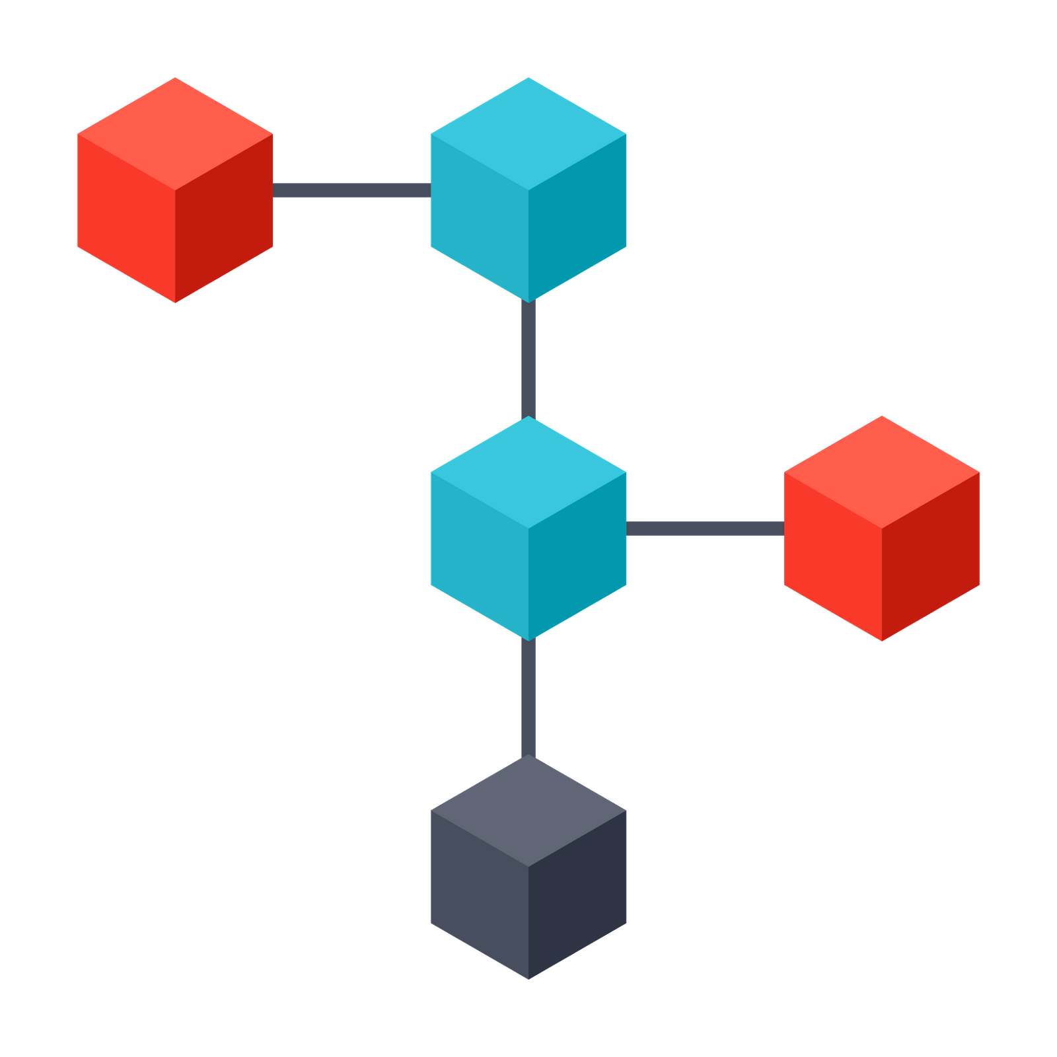
Blockchain-The Future Technology
Blockchain:
Chain of blocks linked together
Each block contains information about the transaction
It is also called distributed ledge
Decentralized
Guided By:
Swagatika Sahoo
Assistant Professor
Prepared By:
Rahul Yadav
21053310

Slide 4
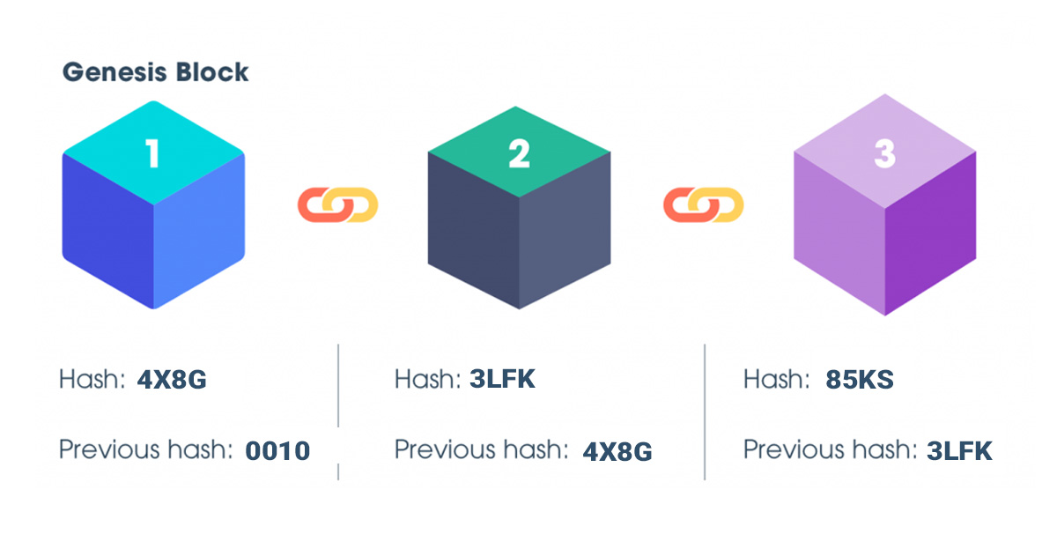
Chain of blocks linked together
Each block contains information about the transaction
It is also called distributed ledge
Decentralized
Blockchain:
Note: Blocks can be accessed in reverse order so it is also called reversed linkedlist.

Slide 5


History:
Bitcoin white paper was publised by pseudo anonymous Satoshi Nakamoto (Oct 31, 2008).
Bitcoin was refered as digital gold.
The total number of bitcoin currency in circulation was kept constant.
New coins can be added only by mining.

Slide 6
History:
Bitcoin white paper was publised by pseudo anonymous Satoshi Nakamoto (Oct 31, 2008).
Bitcoin was refered as digital gold.
The total number of bitcoin currency in circulation was kept constant.
New coins can be added only by mining.
History:
Few years later, Vitalik Buterin released white paper of Ethereum with the aim to achieve something great with this revolutionary technology
In 2015, he along with a number of co-founders released the project Ethereum.
Ethereum helped in the following way:
Decentralized transaction
Decentralized orgranization
No centralized intermediary or centralized governing force.

Slide 7
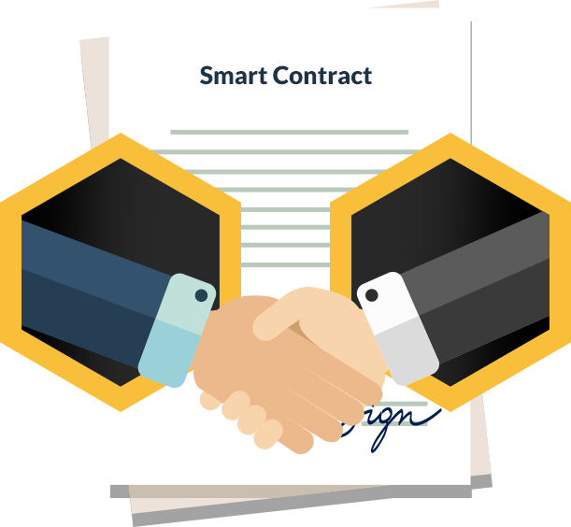
Few years later, Vitalik Buterin released white paper of Ethereum with the aim to achieve something great with this revolutionary technology
In 2015, he along with a number of co-founders released the project Ethereum.
Ethereum helped in the following way:
Decentralized transaction
Decentralized orgranization
No centralized intermediary or centralized governing force.
Smart Contracts:
They are set of instructions executed in a decentralized way.
They are written in code and implemented on a blockchain.
Once the required condition is met, they will be executed automatically without the need for third party intermediary.

Slide 8

They are set of instructions executed in a decentralized way.
They are written in code and implemented on a blockchain.
Once the required condition is met, they will be executed automatically without the need for third party intermediary.
Advantages of Smart Contracts:
Autonomy
Security
Trust
Reduced Intermediaries
Cost Savings
Transparency

Slide 9
Autonomy
Security
Trust
Reduced Intermediaries
Cost Savings
Transparency
Types of Blockchain:
Public: Accessible to all, decentralized
Private: Owned by particular organization and accessible to that group only
Consortium: Group of Organization sharing a common blockchain
Hybrid: Has benefits of both public and private blockchain

Slide 10
Public: Accessible to all, decentralized
Private: Owned by particular organization and accessible to that group only
Consortium: Group of Organization sharing a common blockchain
Hybrid: Has benefits of both public and private blockchain
Types of Blockchain:
Private
Consortium
Public
Hybrid

Slide 11
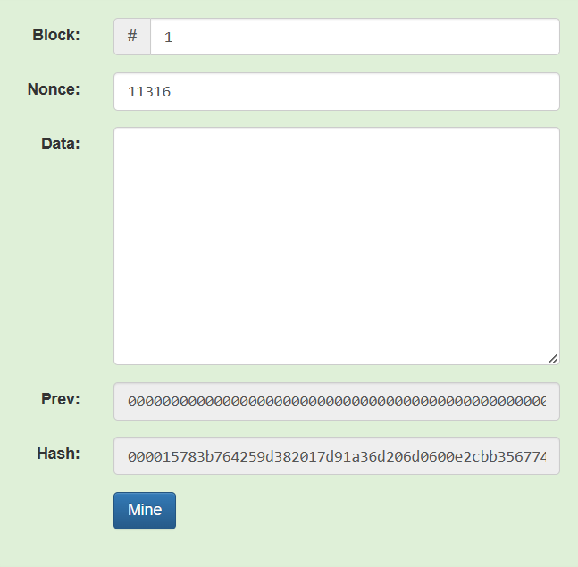
Structure of Block:
Block no.: This field contains the number of the block
Nonce(Number Used Once): This field plays important role in the mining process as this is the only filed which can be altered.
Data: This field stores the transaction information
Prev: Stores the hash of the prev block of the blockchain
Hash: The hash of the current block is stored in this field.

Slide 12

Block no.: This field contains the number of the block
Nonce(Number Used Once): This field plays important role in the mining process as this is the only filed which can be altered.
Data: This field stores the transaction information
Prev: Stores the hash of the prev block of the blockchain
Hash: The hash of the current block is stored in this field.
Structure of Block:
Hash:
It is a unique fixed lenth string, meant to identify a particular block
Block No., Nonce, Data and Prev all combined to form the hash of a particular block.
The hash is generated by using a hash funtion.
There is no pattern in the generated hash and cannot be reversed engineered.

Slide 13

It is a unique fixed lenth string, meant to identify a particular block
Block No., Nonce, Data and Prev all combined to form the hash of a particular block.
The hash is generated by using a hash funtion.
There is no pattern in the generated hash and cannot be reversed engineered.
Structure of Block:
Nonce:
It is Number Used Once.
This is the only field that can be altered in a block.
It plays a vital role in the blockchain mining and adding new block to the blockchain.
Miners alters this field to generated hash of the block which falls under the required pattern or limit.

Slide 14
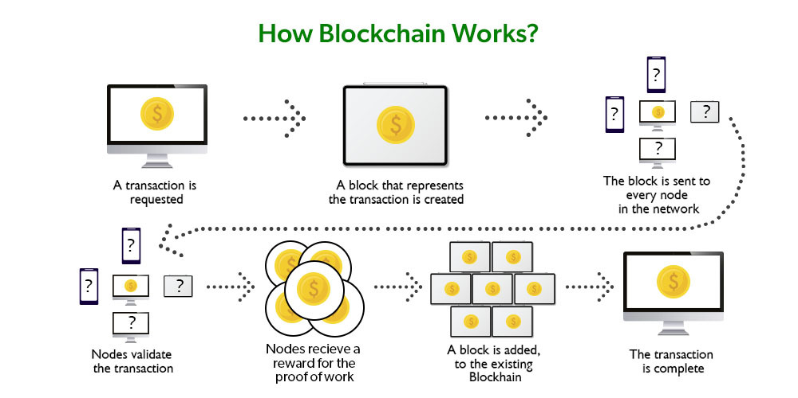
It is Number Used Once.
This is the only field that can be altered in a block.
It plays a vital role in the blockchain mining and adding new block to the blockchain.
Miners alters this field to generated hash of the block which falls under the required pattern or limit.

Slide 15
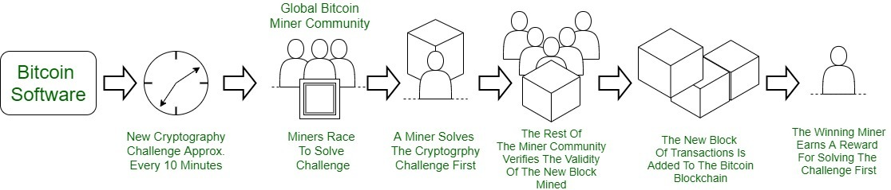
Blockchain Mining:

Slide 16
Blockchain Mining:
As discussed earlier, the mining process is done with the help of nonce.
Demonstration

Slide 17
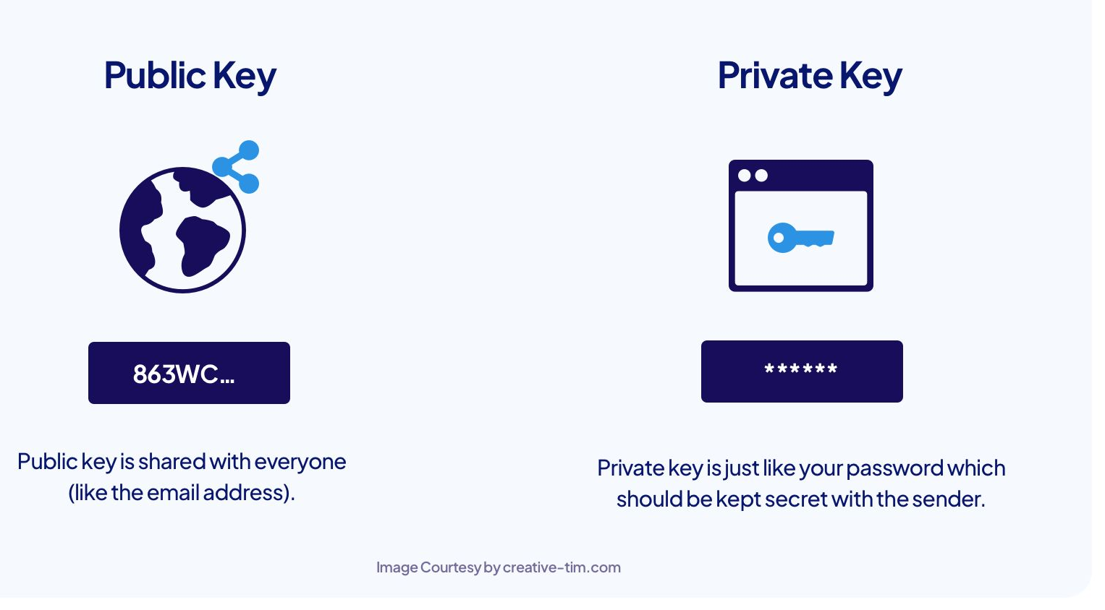
Keys and Signing Transaction:

Slide 18
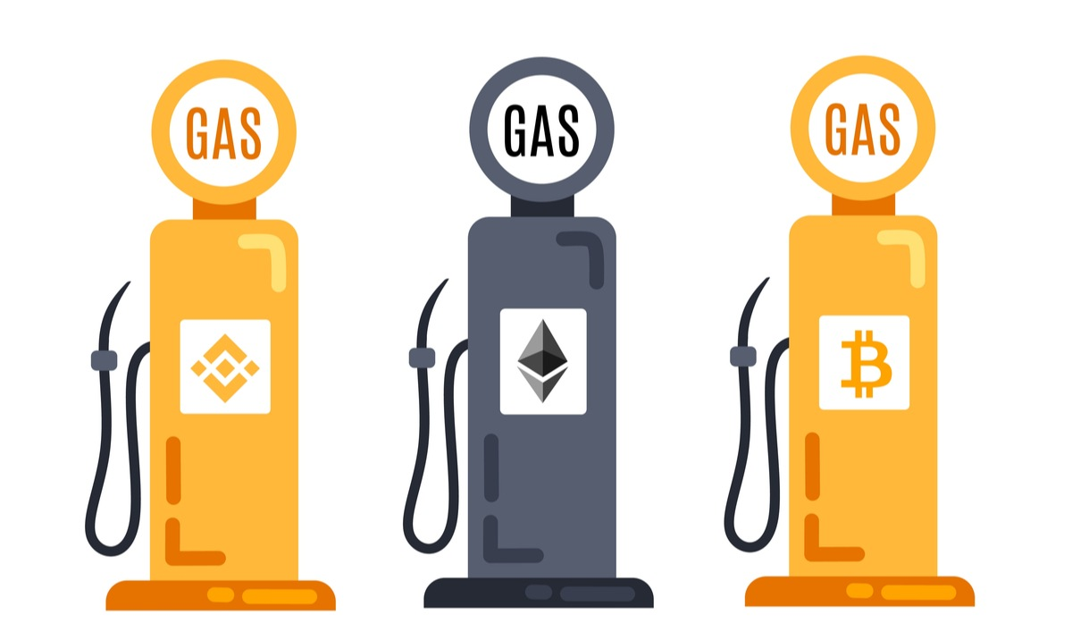
Gas
The transaction fee charged is called gas.
Unit = GWEI
10^-9 ETH = 1 GWEI
Every time a transaction takes place, the sender has to pay gas.

Slide 19
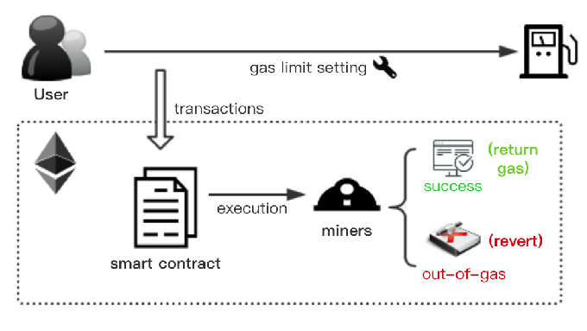
The transaction fee charged is called gas.
Unit = GWEI
10^9 ETH = 1 GWEI
Every time a transaction takes place, the sender has to pay gas.
Gas
Gas limit is the minimum gas required for a transaction to be successful.
Currently, the gas limit is 21,000 units.

Slide 20
Gas limit is the minimum gas required for a transaction to be successful.
Currently, the gas limit is 21,000 units.
Consensus
The mechanism used to agree on the state of blockchain
Consensus
Sybil Resistance
Chain Selection
(longest chain to be the valid one)
PoW
PoS

Slide 21
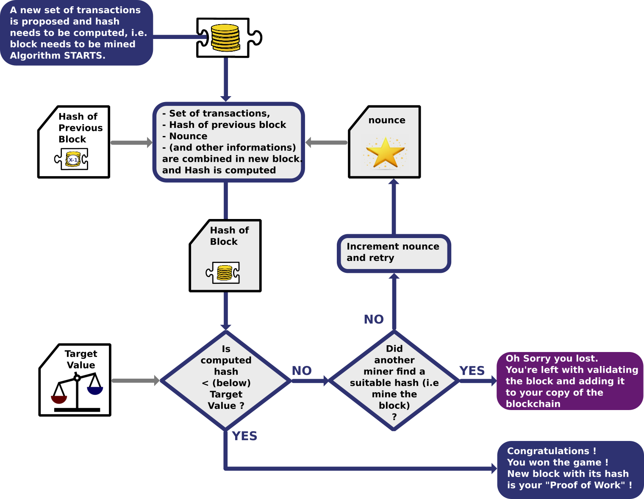
The mechanism used to agree on the state of blockchain
Consensus
Sybil Resistance
Chain Selection
(longest chain to be the valid one)
PoW
PoS
Proof of Work (PoW):

Slide 22
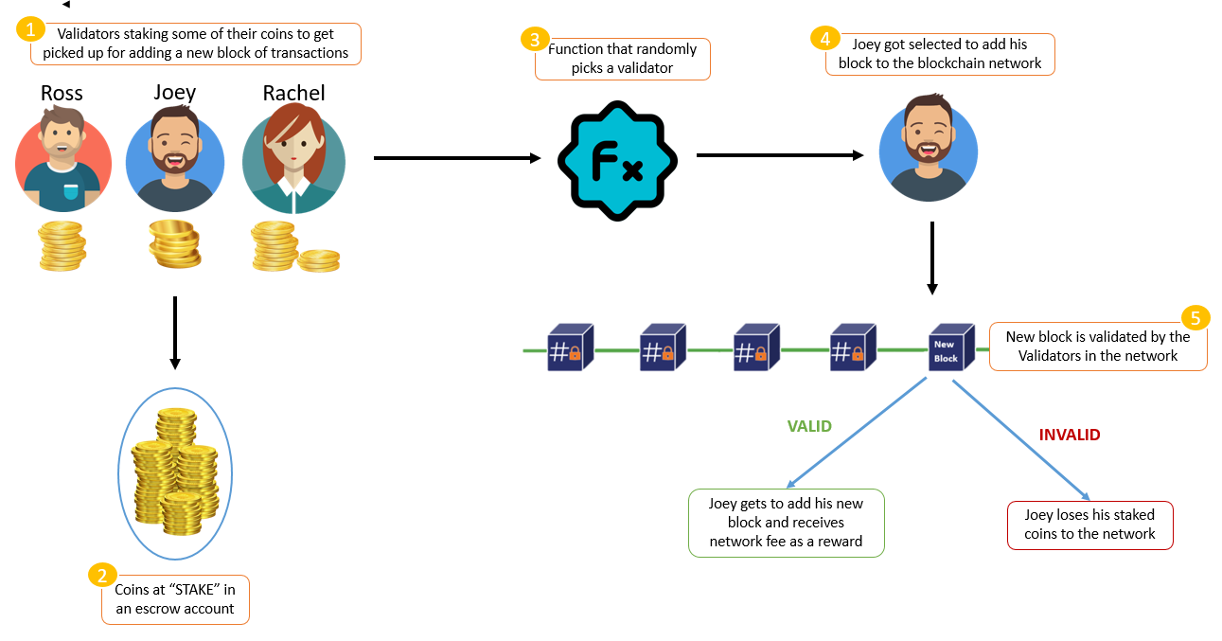
The mechanism used to agree on the state of blockchain
Proof of Stake (PoS):

Slide 23
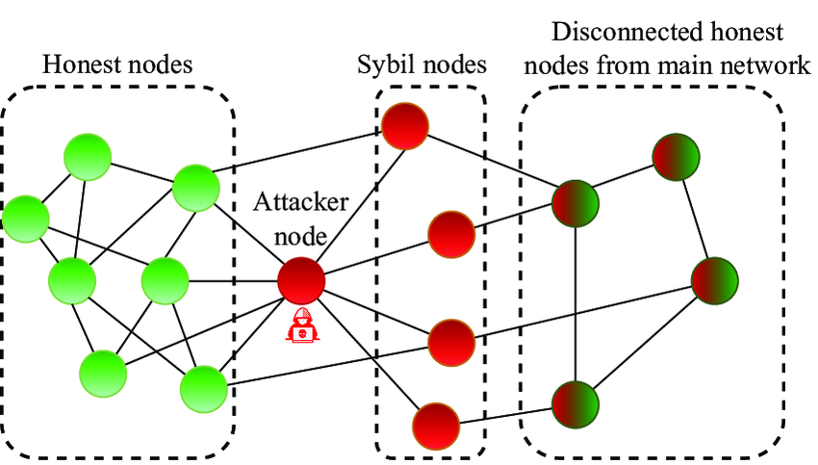
The mechanism used to agree on the state of blockchain
Sybil Attack:
Creating large number of fake accounts/nodes to influence blockchain.
51% attack is a special type of sybil attack.

Slide 24
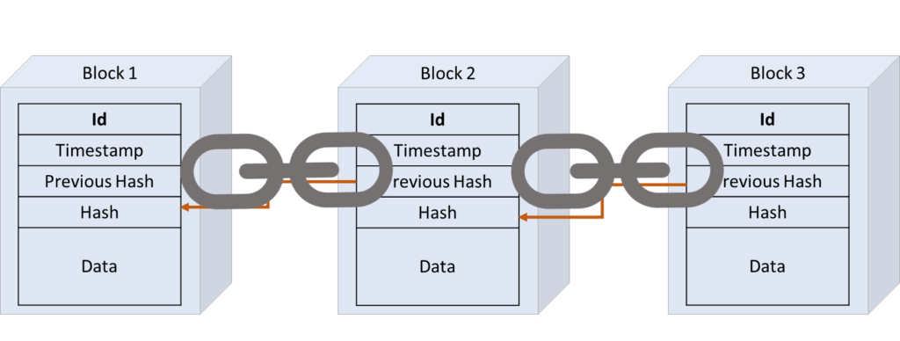
The mechanism used to agree on the state of blockchain
Timestamp:
Creating large number of fake accounts/nodes to influence blockchain.
51% attack is a special type of sybil attack.
It denotes the specific time when the block was added to the blockchain.
It is recored in Unix Timestamp (No. of seconds elapsed since 1st Jan, 1970).
The current Unix epoch time is 1689751395.
It plays vital role in considering the block number.
Also, it is sometime used to prevent the exhaustion of Nonce while mining.

Slide 25
It denotes the specific time when the block was added to the blockchain.
It is recored in Unix Timestamp (No. of seconds elapsed since 1st Jan, 1970).
The current Unix epoch time is 1689751395.
It plays vital role in considering the block number.
Also, it is sometime used to prevent the exhaustion of Nonce while mining.
The mechanism used to agree on the state of blockchain
Disadvantages of Blockchain:
Scalability
Energy Consumption
Cost
Governance and Regulation
Immutability and Data Privacy
Interoperability- lack of interoperability between different blockchain networks can be a significant challenge

Slide 26
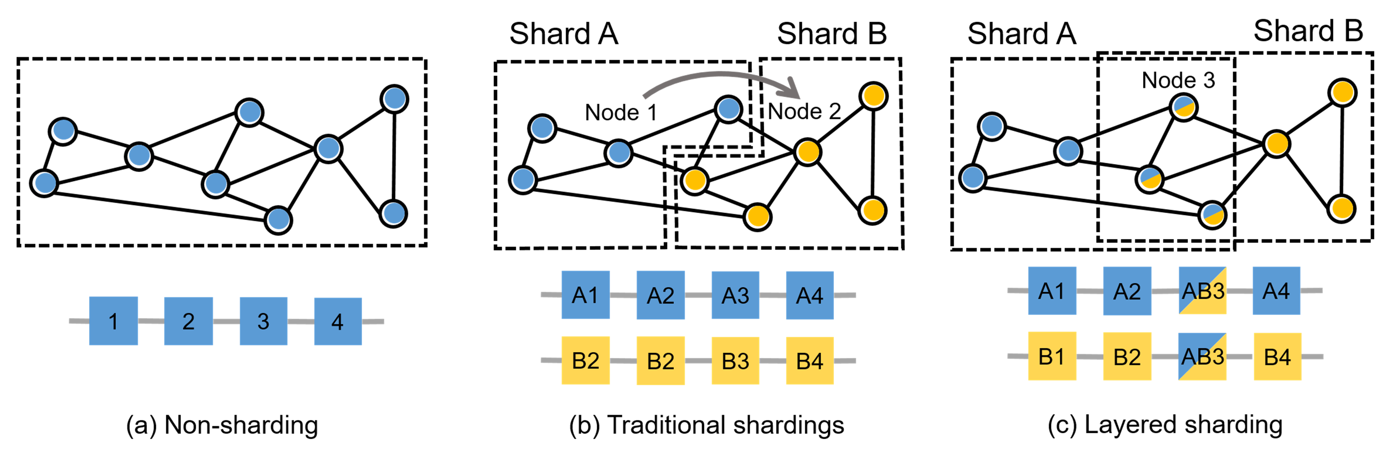
Scalability
Energy Consumption
Cost
Governance and Regulation
Immutability and Data Privacy
Interoperability- lack of interoperability between different blockchain networks can be a significant challenge
The mechanism used to agree on the state of blockchain
Solution to Scalability
1) Sharding

Slide 27
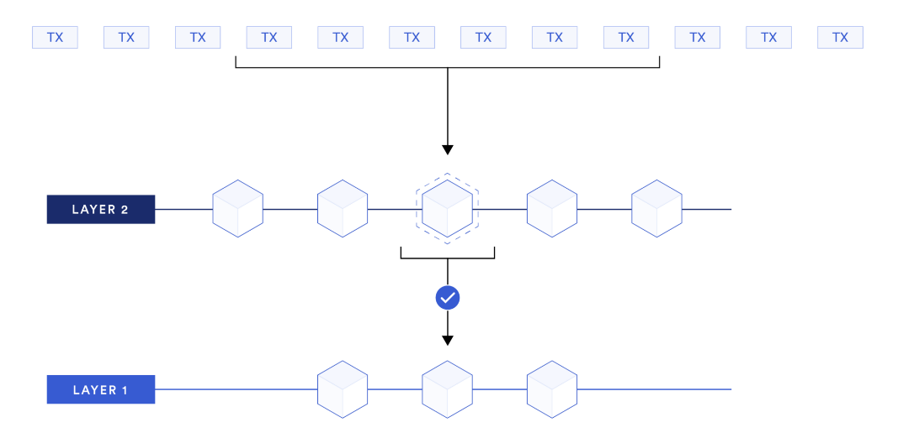
Solution to Scalability
1) Roll-ups

Slide 28


